Slide 1
Pattern Extraction
Stauffer Guy-Raphaël and Chevalley Gibran

Slide 2


Previous work

Slide 3
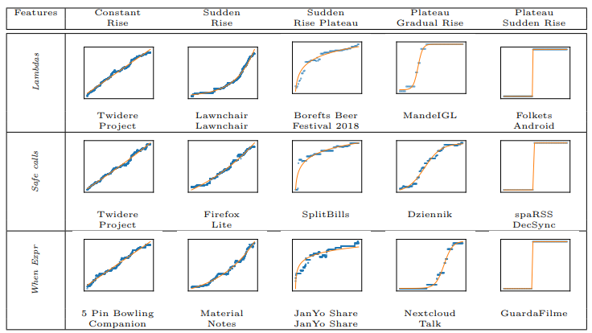
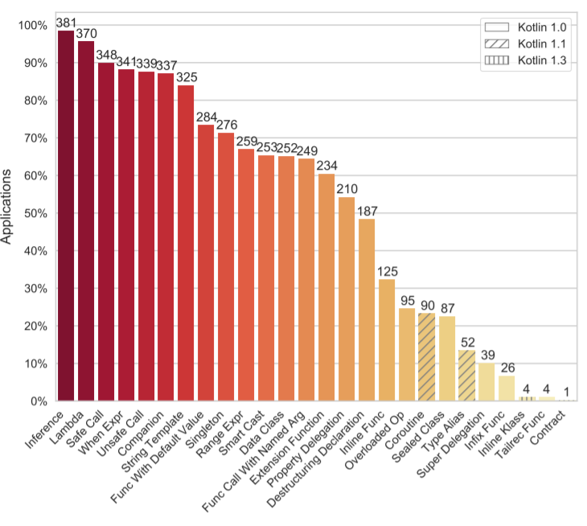
Previous work

Slide 4


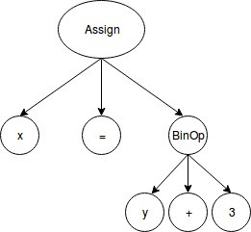
Two keypoints
AST

Slide 5
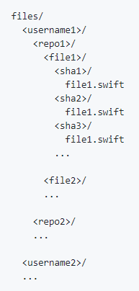

Github exploration
git clone https://github.com/Alamofire/Alamofire
GET https://api.github.com/search/repositories
?q=language:Swift&sort=stars&order=desc

Slide 6
Github exploration
apple/
swift/
0000_Main.swift/
3ac8b92fb595d54b365dee885885e3d7a22c7649/
Main.swift
0453335d5e47781fdd788299920dd380cc9155ef/
Main.swift
…
0001_Requires.swift/
...
Alamofire/
Alamofire/
0000_ContentView.swift/
603defe1fe8ba465da412767fc45e68edac9bc0a/
ContentView.swift
…
0001_DispatchQueue+Alamofire.swift/
…
…

Slide 7





Encountered problems
Renamed files in commit history
Syntax error according to swift-ast
Checkout commits

Slide 8

TODO

Slide 9

TODO
?
?
?
Optional chaining
Protocole, extension
Protocole with bounded generic types
Retroactive modeling
…

Slide 10
Sources
Mateus, Bruno Góis, et Matias Martinez. « On the Adoption, Usage and Evolution of Kotlin Features on Android Development ». ArXiv:1907.09003 [Cs], 20 janvier 2020. http://arxiv.org/abs/1907.09003.

